Slide 1

Competitive Programming From Problem 2 Solution in O(1)
P
T
H
I
N
K
F
A
S
T
S
C Language
Mostafa Saad Ibrahim
PhD Student @ Simon Fraser University

Slide 2
C language
History: C++ to add more features to C
C++ support much of C Syntax
C++ is often considered to be a superset of C
This is NOT strictly true
Things get more complex with more versions of the 2 languages
C++ is much more popular than C
When to use C? Link 1 Link 2
You don’t need to read about C ☺ at least now

Slide 3
C elements vs C++
Dynamic memory
C++ uses new and delete operators
C uses malloc and free functions
Reading and Writing
C++ uses objects, C uses functions
cin vs scanf, cout vs printf
ifstream vs fscanf, ofstream vs fprintf
C++ has these C sytax and more of C

Slide 4
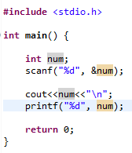

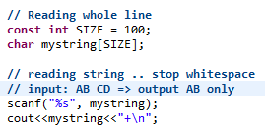

Reading/Writing in C

Slide 5
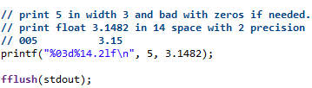
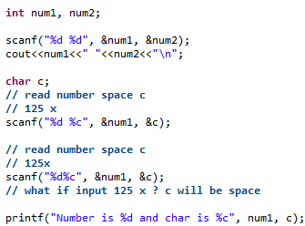
Read-Write multiple

Slide 6


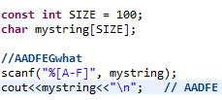
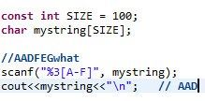


Scanf Scanet(char set)
More: http://www.cplusplus.com/reference/cstdio/scanf/

Slide 7
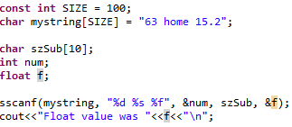

Read-Write with strings

Slide 8
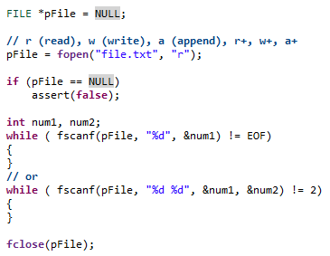
Read-Write with files

Slide 9
Reading/Writing in C: Why?
Sometimes we need to do much reading/writing from/to disk. This is know to be very slow generally.
C++ seems sometime is slower using streams.
Some people says just stop synchronizing themselves with the C library’s stdio buffers, so that you can freely intermix calls to scanf/printf with operations on cin/cout
std::ios_base::sync_with_stdio(false);
Add to that, avoid endl

Slide 10
Preprocessor Directives
Directives: Lines preceded by # ... and don't end with ;
#include <cmath>
#define NAME "Mostafa"
NOT program statements
but directives for the preprocessor
Preprocessor: a program pre-processes the code and generate other code FIRST before actual compilation.
Each directive tells the preprocessor to do something in the code (e.g. Replace something with other thing)

Slide 11
#include Directive
Source file inclusion directive
It tells preprocessor to replace it by the entire content of the specified header or file.
#include <cmath>
<> headers provided by the implementation
E.g. Standard Library
#include "Employee.h“
Search first in current path..if NOT same as <>

Slide 12
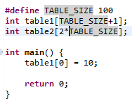
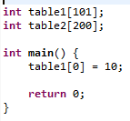
Macro Directive
Format: #define identifier replacement
replaces any occurrence of identifier in the rest of the code by replacement
replacement can be anything
Generated
code

Slide 13
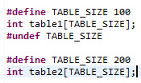

Macro Directive
A macro lasts until it is undefined with the #undef preprocessor directive:
Generated
code

Slide 14
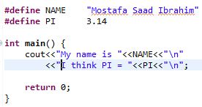
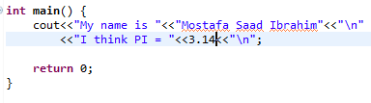
Macro Directive

Slide 15
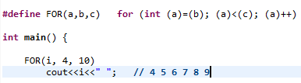
Macro Directive

Slide 16
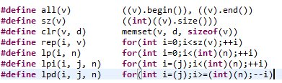
Macro Directive: Competitions
And more at
http://www.quora.com/What-are-some-macros-that-are-used-in-programming-contests

Slide 17

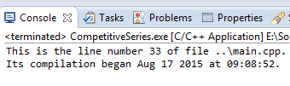
Defined Macros

Slide 18
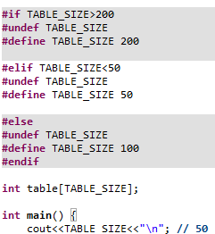
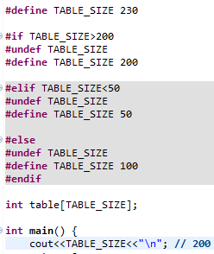
Conditional Inclusion Directive
#ifdef, #ifndef, #if, #endif, #else and #elif

Slide 19
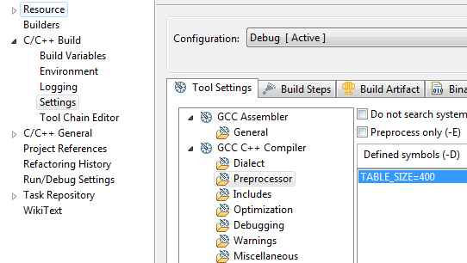
Define a preprocessor for project

Slide 20
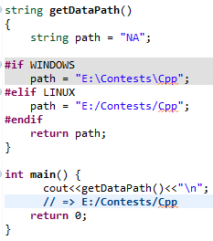

A real life usage

Slide 21
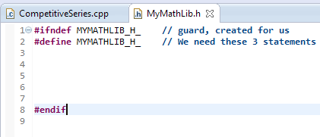
Remember?

Slide 22
More?
See
But you don’t need to know more ☺
#include + header guard are mainly enough
In real life apps, developers don’t prefer to use MACROS in C++
Macros are from C
C++ has templates, much more powerful

Slide 23
تم بحمد الله
علمكم الله ما ينفعكم
ونفعكم بما تعلمتم
وزادكم علماً

